Slide 1
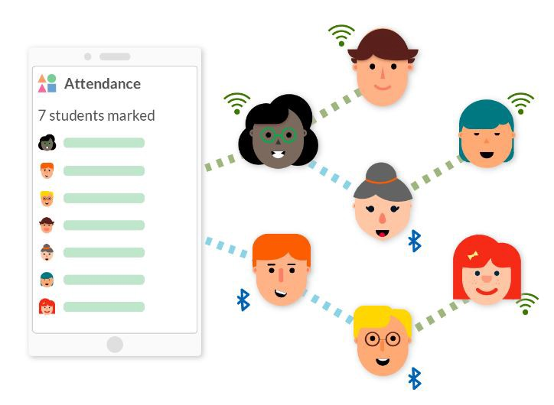

MINI PROJECT :-
EMPLOYEE ATTENDANCE BY
FACE RECOGNITION
(2020-2021)
Presented By-
Manisha Negi
Course : B.tech (CSE)
Section: B
Roll no.: 30
( 6th semester)

Slide 2
CERTIFICATE
Certified that Ms. Manisha Negi (Roll No.- 1018517) has developed mini project on “Employee Attendance system by Face Recognition” for the CS VI Semester Mini Project Lab in Graphic Era Hill University, Dehradun. The project carried out by Students is their own work as best of my knowledge.
Date: 19/06/2021
(Mr. Avnish Panwar)
Project Co-ordinator
CC-CSE-B-VI-Sem
(Dr. Mahesh Manchanda, Ms. Preeti Chaudhary, Ms. Kiran Kumain)
Project Guide
Resource Person

Slide 3

INDEX
About project
Main objective
Project requirement
5. methodology
6. Working of project
7. Conclusion

Slide 4

ABOUT PROJECT
Among the various types of attendance systems that have been developed, using punch cards, log books, fingerprint systems, barcodes, QR codes and also RFID still cause lots of problems such as providing incorrect information to the users.
The purpose of the Face Recognition attendance system is to computerize the traditional way of recording attendance and provide an easiest and smart way to track attendance in institutions nowadays, the most effective way that have been come into account in marketing and business are Face Recognition. Moreover, it is easy to record attendance.

Slide 5
MAIN OBJECTIVE
“Face Recognition Based Attendance System” is a combination of two android applications developed for taking and storing the attendance of the employees on the daily basis. Here the admin, who is handling the back end, will be responsible to mark the attendance of the employees. “Face Recognition Based Attendance System” is a combination of two methods developed for taking and storing the attendance of the students on the daily basis in the office or work place. Here the admin, who is handling the back end, will be responsible to mark the attendance of the employees.
Each staff will be used to sacn their face that is used for taking attendance and generate the overall attendance status. An accurate report based on the employee attendance is generated here. Report of the employees attendance on daily basis is generated. The main objective of the automated attendance system is to computerize the traditional way of recording attendance and provide an efficient and automated method to track attendance in institutions.

Slide 6

PROJECT REQUIREMENT
Software Requirements
PyCharm
Excel Sheet
Python Libraries
Hardware Requirements
WebCam

Slide 7

METHODOLOGY
The methodology of this project design includes implementation of the proposed method. There are some basic steps involving in the Methodology of the product. The first major step is to take images of the employees. Then I have used excel sheets to store the attendance of the employees. For the program I have used the IDE PyCharm so that it would to be easy to build the python program for the project. I have imported libraries to make my project run. By following these three steps, the implementation of the proposed system is going to be done.

Slide 8
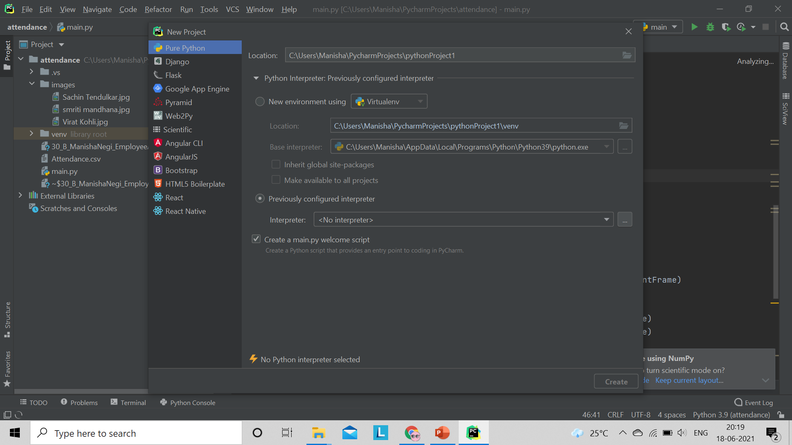
1. First, open PyCharm and add required functionalities and import libraries.

Slide 9

Libraries used :
Cmake
Numpy
Face_recognition
Dlib
Opencv-python
datetime

Slide 10
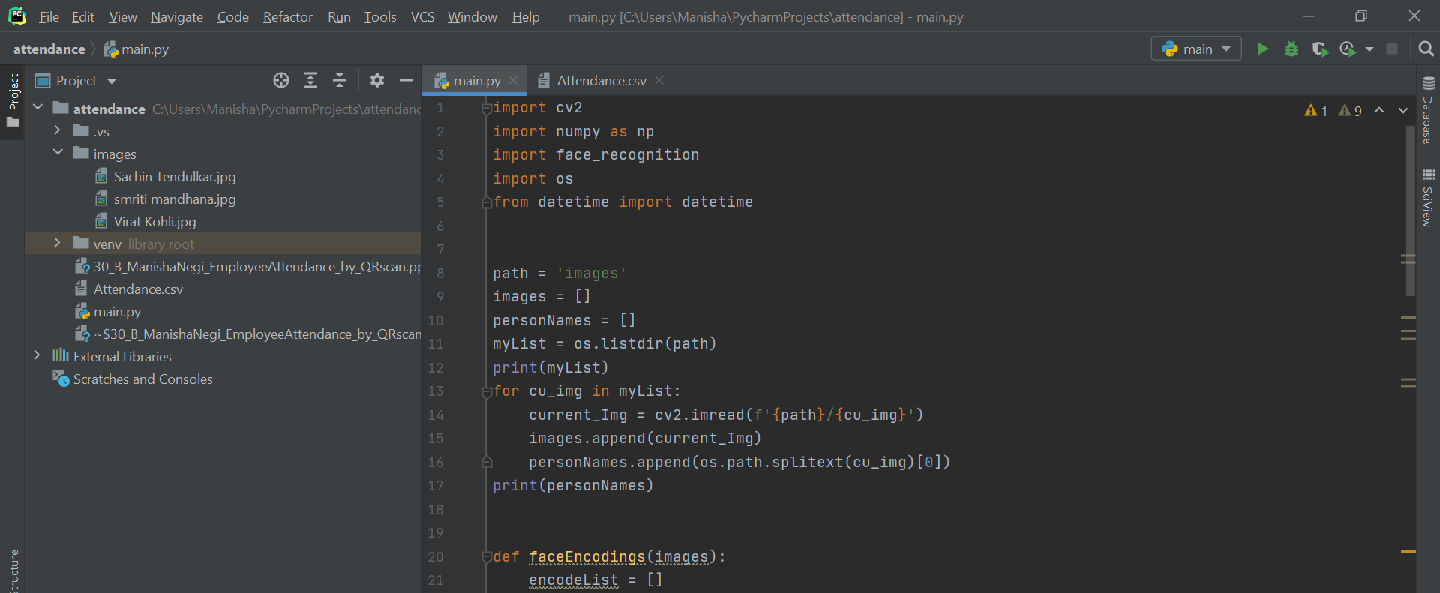
2. Now, start writing the program in main.py file.

Slide 11
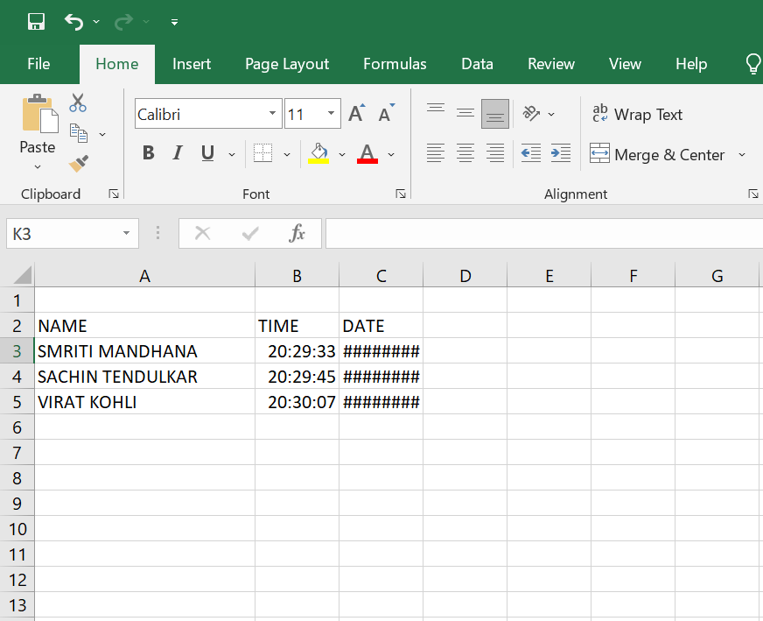
3. Make sure you have made an excel sheet to store the data.
I have used a csv file to record the employee attendance.

Slide 12
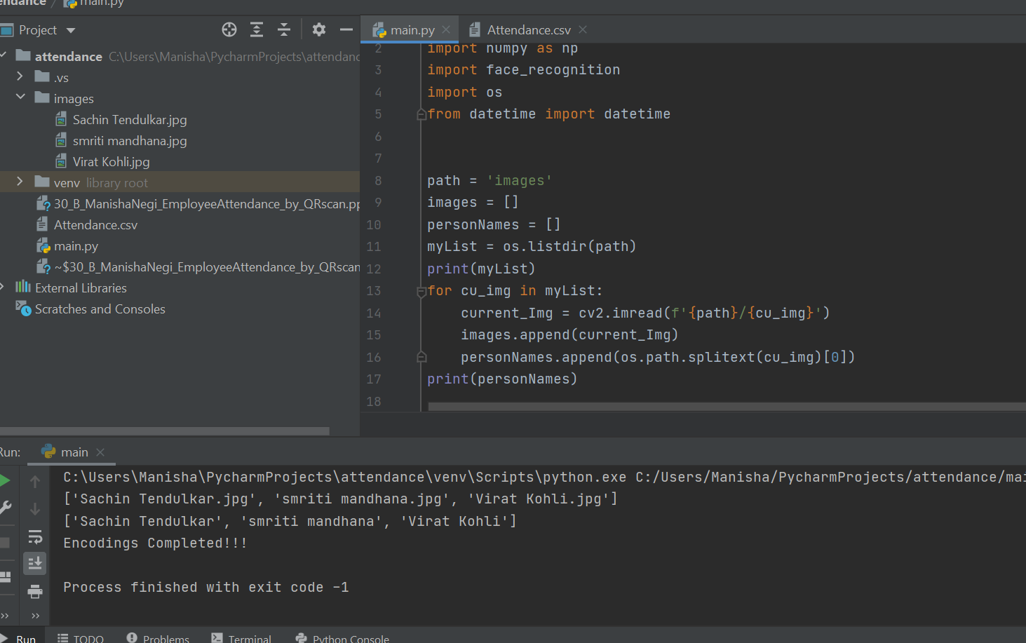
WORKING OF PROJECT
1
Run the main file

Slide 13
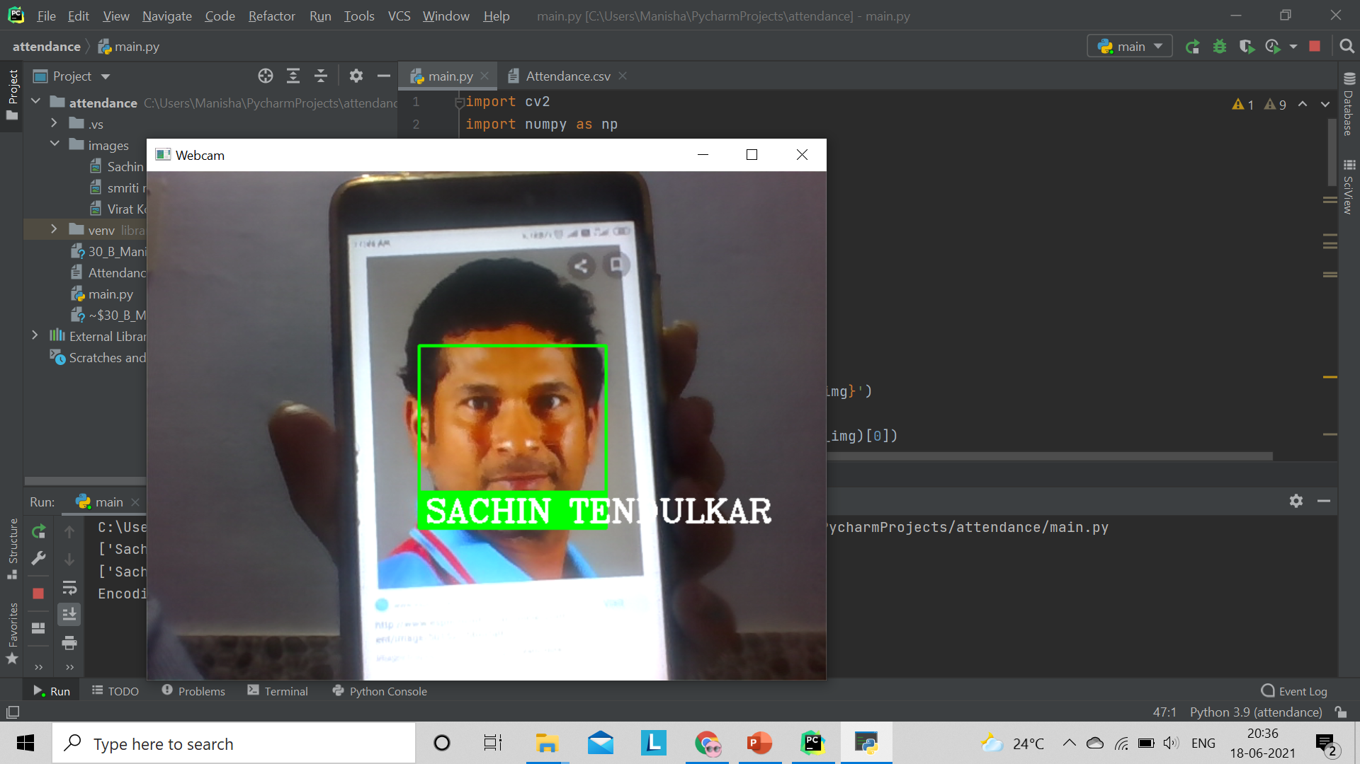
2.Now, the webcam will open to recognize the face. Scan an image or face of person.

Slide 14
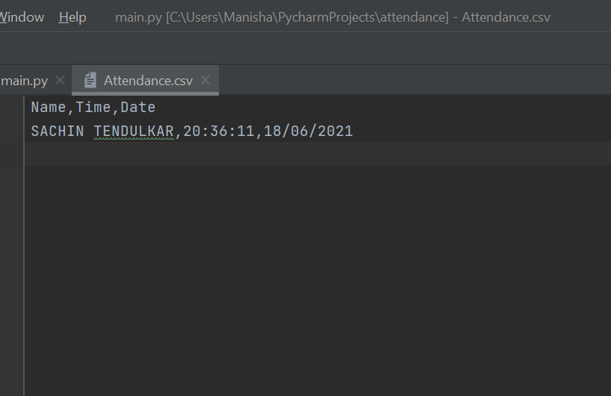
3. The name, time and date will be stored in the csv file.

Slide 15
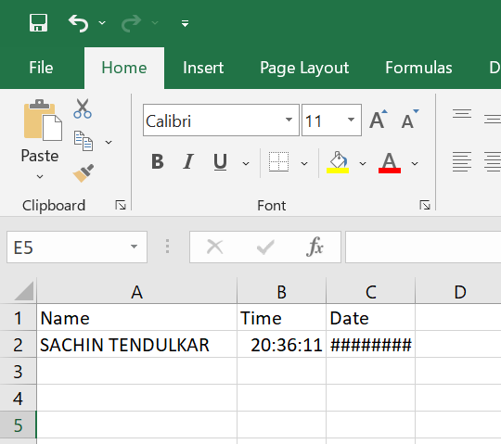
4. We can see the attendance in csv file in tabular form.

Slide 16

CONCLUSION
The developed system presented in this paper has been successfully designed and tested. The Employees attendance status will be analysed and exported.
Attendance monitoring system is very important in our daily life. It is possesses a really great advantage, among the whole types technology, Face Recognition Smart Attendance System is the most accurate.
In this project report, we have given an introduction of Attendance monitoring system and its advantage. It is an efficient method to store the attendance in a smart way rather than wasting the paper.

